Slide 1
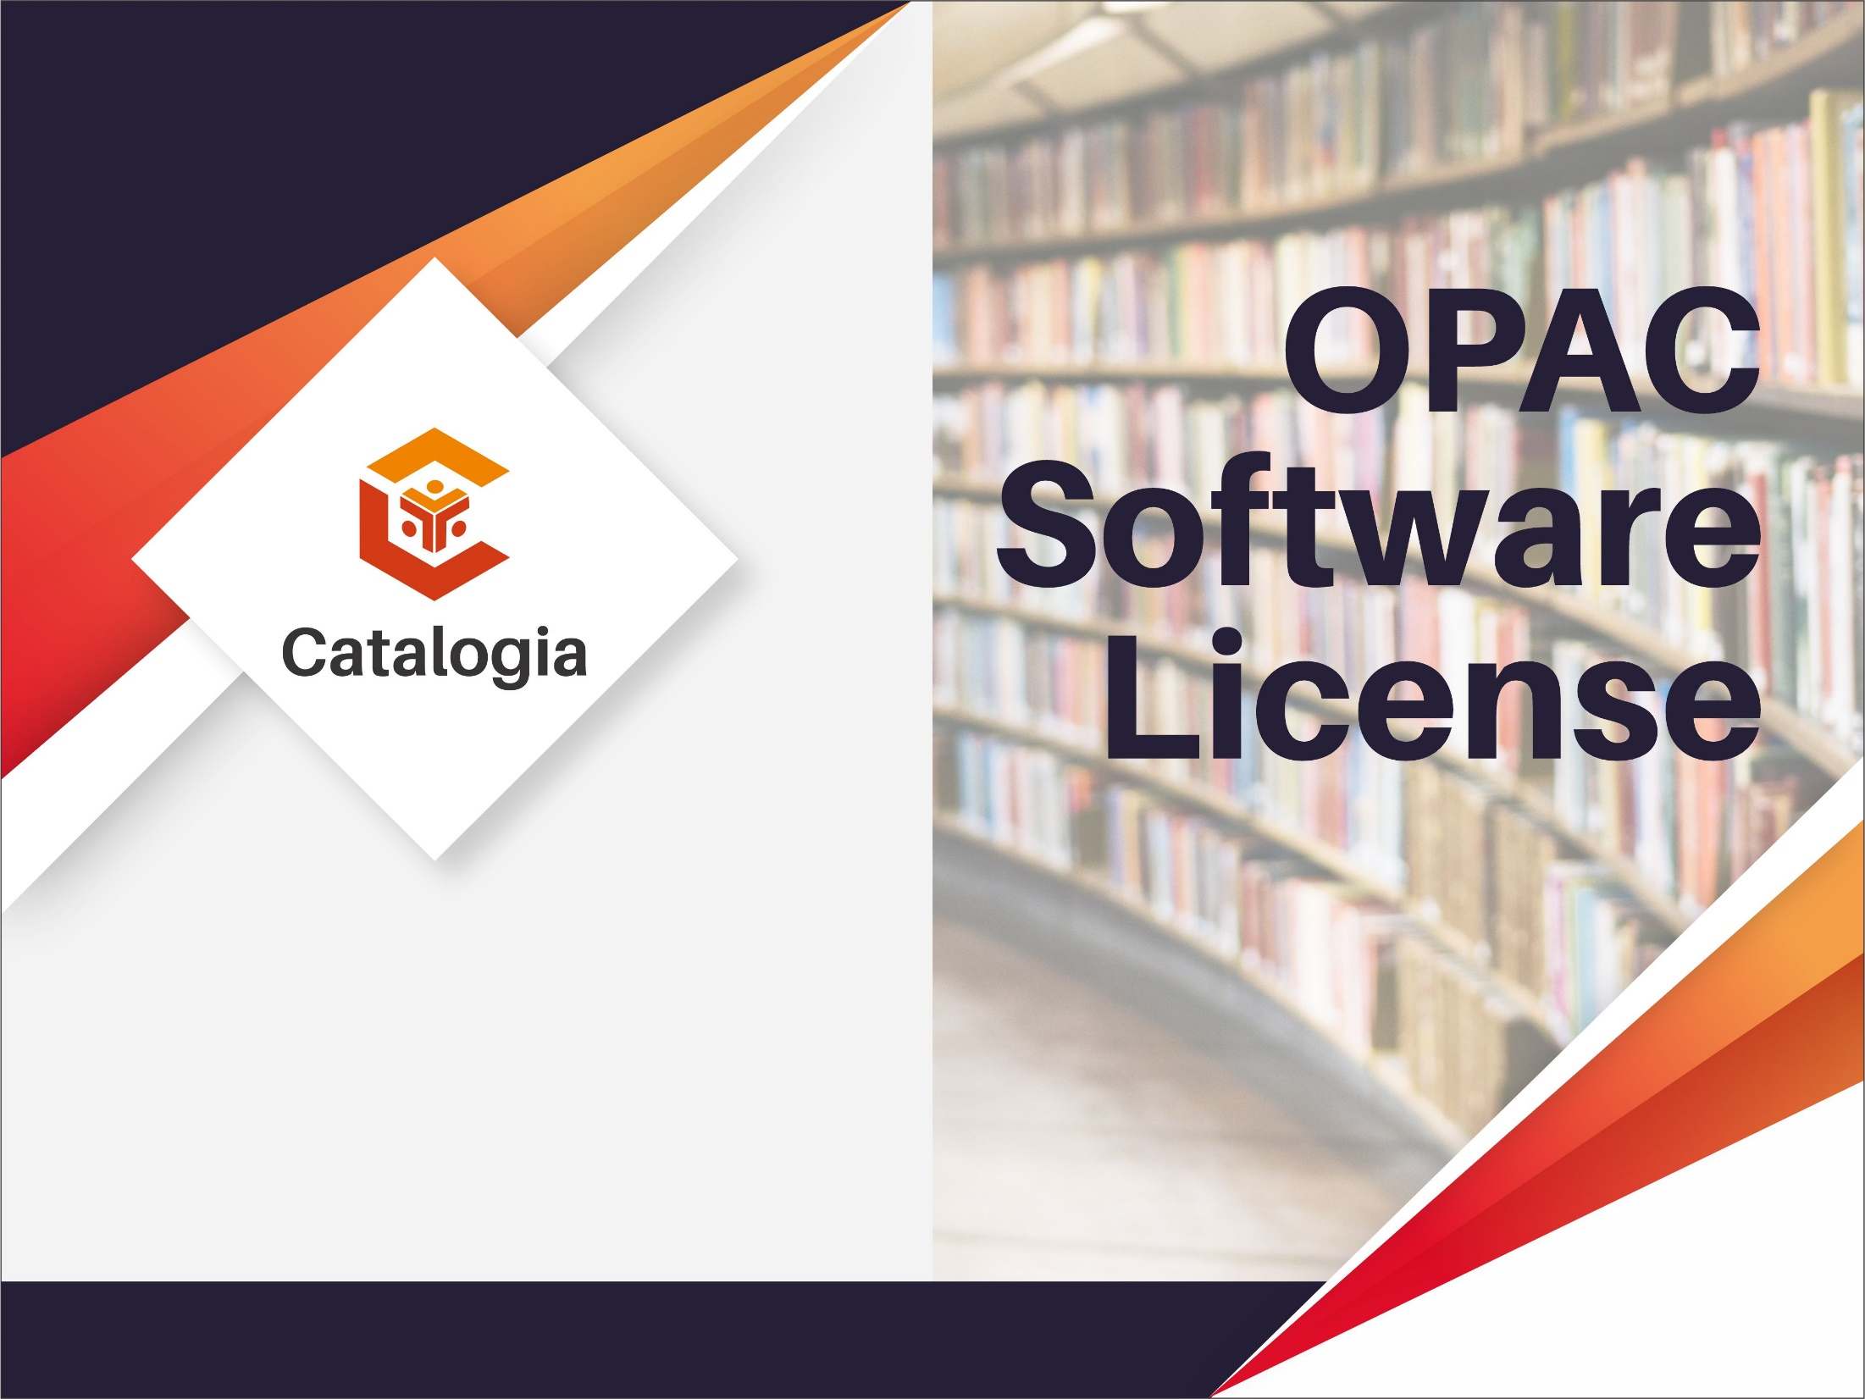

Slide 2
Overview
OPAC is a technological development in library science, in addition to providing convenience for users, it is also easy for library officials to carry out cataloging activities.
OPAC is an installed catalog system that is publicly accessible and can be used by users to browse catalog data (to check whether the library stores a particular work to get information about its location and if the catalog system is linked to a circulation system, the user can find out if the library material is being searched for). available in the library or on loan.

Slide 3
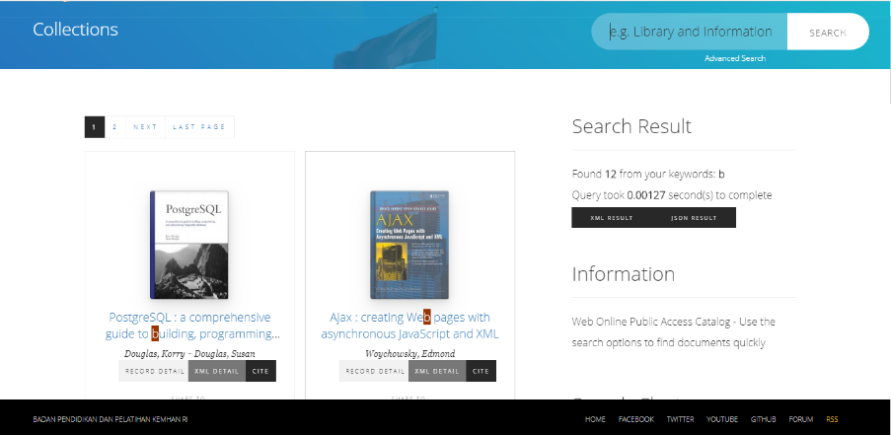

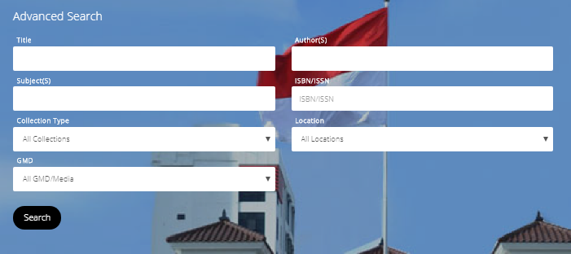
Features
Simple Search
search for library materials using various access points, eg author, title, subject, location and status.
Penelusuran Spesifik
pengguna diharapkan lebih spesifik mencari bahan perpustakaan melalui titik akses baik pengarang, judul, subjek dan lainnya

Slide 4
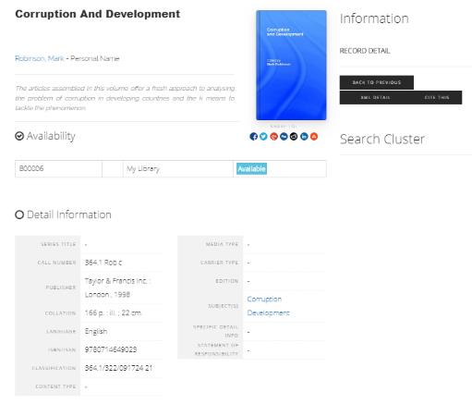

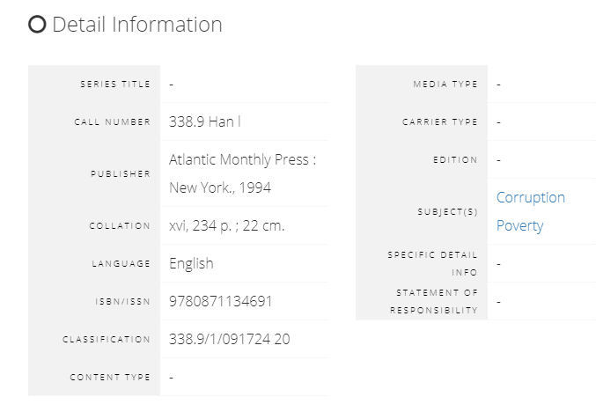

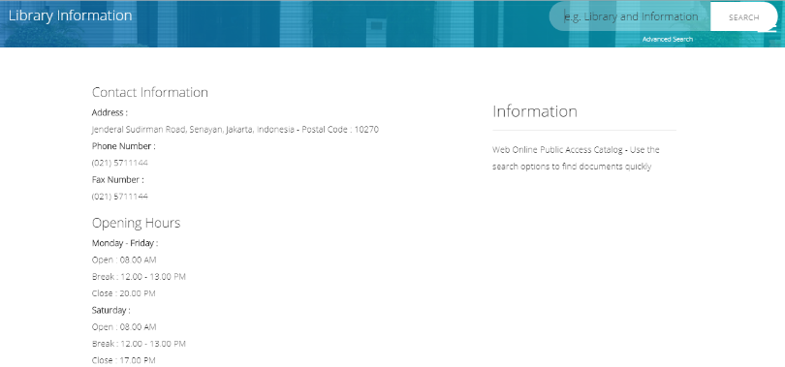
Features
Collection Location
Reduce the burden of time needed and the time spent by users in searching for book information and the location of library collections
Library Information
Information about the library, displaying library location information, library operating hours and other information about the library

Slide 5

Thank you

